Slide 1

Digital Health Companion Initial Presentation
Pentagon Nexus Consulting Group
Simon Sarkodie 8960492
Mohana Dutta 8990773
Ya-Jwu Jang 9015996
Meet Patel 9019384
Vasukrishna Bhalodia 9018135
Notes:
Capstone Project
Blair Moch
INFO8687
Section 1
Sept. 22 2025
Simon Sarkodie 8960492
Mohana Dutta 8990773
Ya-Jwu Jang 9015996
Meet Rajendrakumar Patel 9019384
Vasukrishna Ashokkumar Bhalodia 9018135

Slide 2


Table of Contents
1 | Introduction
2 | About CGI
3 | Competitive & Strategic Analysis
4 | The New Initiative
5 | Conclusion

Slide 3

1
Introduction

Slide 4
Executive Summary
CGI Inc. is a trusted IT consulting partner in Canada, with stable contracts, strong finances, and deep sector expertise. However, as digital transformation speeds up, CGI must adapt to client needs, adopt new technologies, and expand into commercial markets. This project outlines opportunities to optimize core IT operations with AI and automation, while also identifying growth strategies. Using benchmarking, process mapping, and solution design, we provide a roadmap to help CGI stay competitive and agile in a fast-changing industry.

Slide 5





Team Pentagon Nexus Consulting Group
Simon Sarkodie
Julie Jang
Meet Petel
Mohana Dutta
Project Manager
Associate Project Manager
Business Analyst
Business Analyst
Vasurishna Bhalodia
Business Analyst

Slide 6
About CGI
2

Slide 7
ABOUT CGI
Founded in 1976, HQ in Montreal, Canada
One of the world’s largest IT consulting firms (90,000+ staff)
Serves government, finance, telecom, healthcare, and manufacturing
Provides end-to-end IT services: consulting, integration, outsourcing
Strong reputation for long-term government contracts and expertise

Slide 8
Vision, Mission, and Dream
Vision
Mission
Dream
To be a global world-class end-to-end IT and business consulting services leader helping our clients succeed.
To help clients succeed through outstanding quality, competence, and objectivity, providing thought leadership and delivering the best services and solutions to fully satisfy client objectives in information technology, business processes, and management
To create an environment in which we enjoy working together and, as owners, contribute to building a company we can be proud of

Slide 9






Leadership Team
Serge Godin
Julie Godin
Founder of CGI and Co-Chair of the Board of Director
Executive Chair of the Board of Directors
François Boulanger
Benoit Dubé
Steve Perron
Steven Starace
President and Chief Executive Officer
Executive Vice-President, Legal & Economic Affairs, & Corporate Secretary
Executive Vice-President and Chief Financial Officer
Senior Vice-President, Human Resources

Slide 10
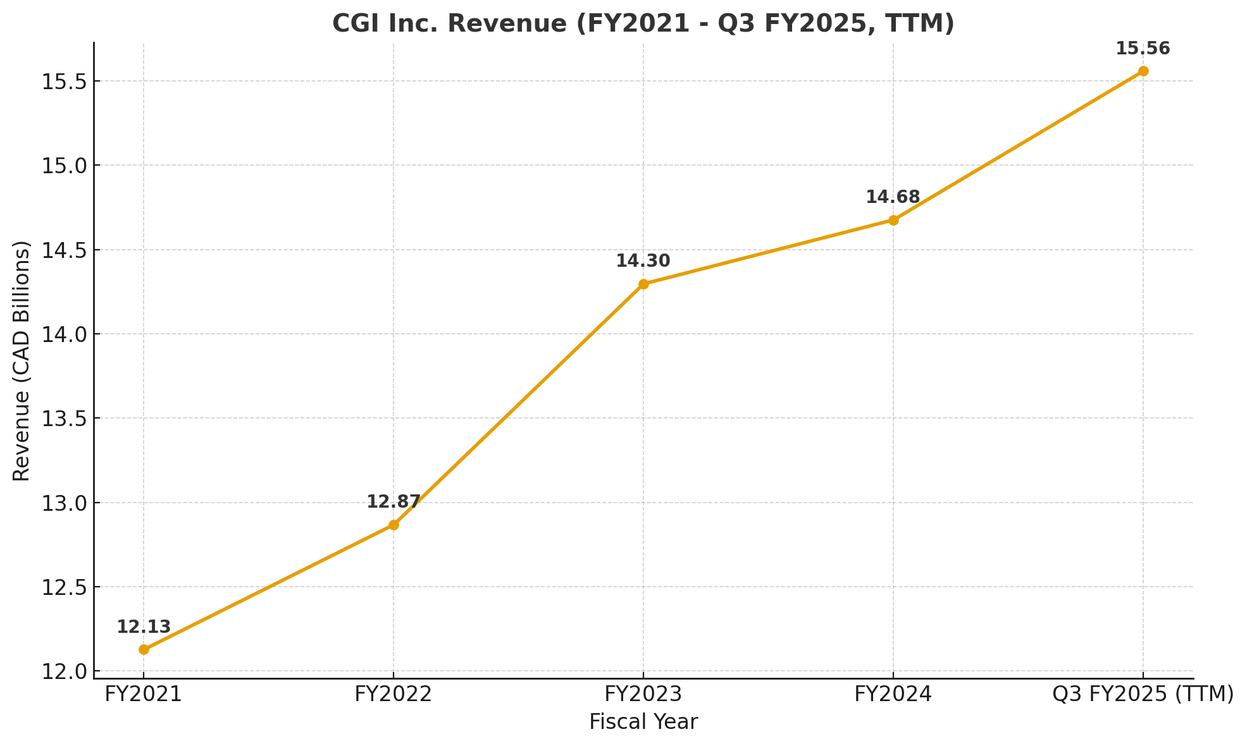
Current State of CGI
CGI is getting a significant amount of revenue from the public sector, particularly in Canada, United States. Federal, provincial/ state, and municipal governments contracts remain the edge of the CGI business model, precisely in IT outsourcing and large-scale government system.

Slide 11
Current Growth Strategy
Employee Share Purchase Program (SPP) to stabilize market performance
Acquires small to mid-sized firms to sustain market share
Current KPT:
Metric | Current Value
% Revenue from Government | 38%
% Revenue from Private Sector | 62% combined
Brand Visibility | Moderate
% of Services in AI/Cloud | 35%
OPEX per Project | CAD $2.5 M
Share Repurchase (SPP) | 90% employee participation
Acquisitions | Ongoing (small/mid firms)

Slide 12
3
Competitive & Strategic Analysis

Slide 13
SWOT Summary
MARS
VENUS
JUPITER
SATURN
 | Strengths | Weaknesses | Opportunities | Threats
CGI Inc. | Scale, stable revenue base, public/private sector mix | Acquisition risks, debt load | AI, cloud, digital transformation | Competition, integration risks
OpenText | Platform leadership, rapid cloud innovation | Integration complexity, sales volatility | Expansion, AI, global SaaS | Commoditization, shifting tech landscape
Shopify | Fast growth, global merchant base, platform extensibility | Gross margin pressure, merchant dependency | International expansion, fintech, AI | Tech disruption, regulatory risk
Constellation Software | Acquisition expertise, niche markets | Integration risks, decentralized ops | Cross-industry expansion, new segments | Macro trends, competitive deals
Mars is actually a very cold place
Venus is the second planet from the Sun
It’s the biggest planet in the System
Saturn is a gas giant and has rings

Slide 14
PESTEL Analysis
Factor | CGI Inc. | Shopify | OpenText | Constellation Software
Political | Heavily reliant on government contracts and public sector spending. | Sensitive to global e-commerce regulations and trade policies. | Must navigate data sovereignty and complex procurement rules. | Depends on stable markets for its acquisition-led growth model.
Economic | Exposed to global economic trends and client IT budget cycles. | Success directly tied to SME health and consumer spending. | Resilient due to enterprise subscription models but not immune to downturns. | Defensive model focused on acquiring recession-resistant businesses.
Social | Adapting to hybrid work models and client demands for digital experiences. | Driven by evolving online shopping trends and consumer privacy concerns. | Demand fueled by business needs for secure remote collaboration. | Value is preserved by retaining talent and customers post-acquisition.
Technology | Strategic focus on AI, cloud, and automation to maintain a competitive edge. | Continuous platform innovation (AI, payments) is mandatory to survive. | Core roadmap is centered on cybersecurity and AI in information management. | Diversified tech risk across its portfolio; modernization is an ongoing challenge.
Environmental | Growing importance of ESG reporting for public contracts and investors. | Responds to merchant and shopper demand for sustainability features. | Driven by corporate customer expectations for sustainability practices. | Low direct exposure, but faces growing stakeholder pressure for ESG efforts.
Legal | Navigates complex global data privacy and procurement laws as a key risk. | Faces significant risk from changing data privacy regulations (GDPR, etc.). | Uses compliance capabilities (GDPR) as a key product differentiator. | Legal focus is primarily on M&A due diligence and governance.

Slide 15
Balance Score Card
Perspective | CGI Inc. | Shopify | OpenText | Constellation Software
Financial | Strong and steady profitability | High growth, volatile profitability | Stable margins, consistent earnings | Consistent returns via aggregation
Customer | Broad enterprise clientele | SMBs & marketplaces | Large enterprise and government clients | Vertical market specialists
Internal Process | Proven delivery through decentralization | Highly agile software development | Strong R&D integration and AI deployment | Acquisition and product integration success
Learning & Growth | Skilled workforce, M&A enhancing capabilities | Innovative culture and rapid scaling | AI/security expertise focus | Integrated expertise across domains

Slide 16
Summary & Strategic Contrast
Builds on long-term government and enterprise service contracts.
Weaknesses / Risks
Growth is heavily tied to public sector spending cycles
Different growth model than tech-focused rivals

Slide 17
The New Initiative
4
CGI Digital Health Companion

Slide 18
Concept
The CGI Digital Health Companion is a secure, AI-powered mobile application designed to integrate with consumer wearables (e.g., Fitbit, Apple Watch) and digital health tools.

Slide 19
Core Features
AI-Powered Mobile App
Continuous Health Monitoring
Medication and Care Plan Reminders
Provider and Family Connectivity
Personalized AI Health Insights
Universal Data Interoperability
Privacy and Security

Slide 20
Strategic Rationale
Builds on CGI’s established expertise in government healthcare IT systems but extends into the consumer side of healthcare.
Meets growing demand for digital health apps and remote patient monitoring (McKinsey Digital, 2023).
Positions CGI as a trusted B2C partner in a space often dominated by startups with less credibility.

Slide 21
Expected Benefits
B2C Value
Diversification
Patients have control over their own health data.
Reinforce our position as an innovator in consumer health.
Sustainable revenue from a SaaS subscription model.
Brand Positioning
Revenue Potential
Healthcare Impact
Reduced reliance on public sector contracts.
Promote preventive care to lower long-term healthcare costs.

Slide 22
Why We Selected This Initiative?
It leverages our current healthcare IT proficiency and extends it into the consumer market.
Aligns with existing CGI expertise
Aligns with existing CGI expertise
The global digital health market is projected to reach $650 billion by 2030.
Most current health applications are fragmented. CGI can provide a compliant, secure, and integrated platform.
Addresses market fragmentation
Strengthens CGI's product capabilities
This initiative enhances our competitiveness by focusing on product development, not just services.
2020
2021
2022
Neptune is far away from us
Mars is full of iron oxide dust
Jupiter is the biggest planet

Slide 23
5
Conclusion

Slide 24
A New Direction for CGI
From Institutional Partner to Consumer Innovator
Historic Strength
Strategic Opportunity
Future Vision
CGI's success is built on providing mission-critical IT solutions for governments and enterprises.
The CGI Digital Health Companion diversifies our portfolio, reducing exposure to public-sector risks.
This product transforms CGI into a trusted digital healthcare partner, bridging the gap between institutional and consumer health.

Slide 25
The End

Slide 26
References
CGI Inc. (2025a). About us. https://www.cgi.com/en/about-us
CGI Inc. (2025b). Investment profile. https://www.cgi.com/en/investors/investment-profile
CGI Inc. (2025c). Healthcare solutions. https://www.cgi.com/en/health
McKinsey Digital. (2023). Technology Trends Outlook 2023. https://www.mckinsey.com/mti/technology-trends-outlook
Seeking Alpha. (2025, July 24). CGI Q3 Preview: U.S. Federal Exposure Is a Huge Risk. https://seekingalpha.com/article/4804218
European Union. (2018). General Data Protection Regulation (GDPR). Official Journal of the European Union.

